Slide 1

ARUS DAN TEGANGAN BOLAK-BALIK
PERTEMUAN 14
PROGRAM STUDI INFORMATIKA
UNIVERSITAS INDRAPRASTA PGRI
2020

Slide 2
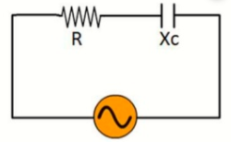
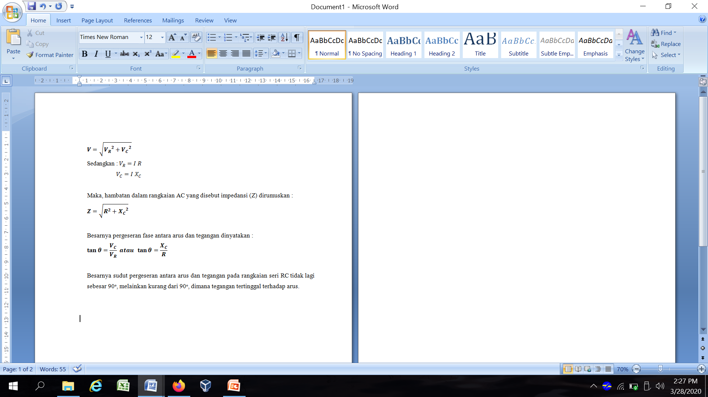
Rangkaian RC Seri
Gambar 1
Rangkaian RC Seri

Slide 3
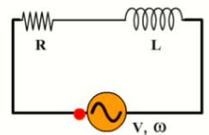
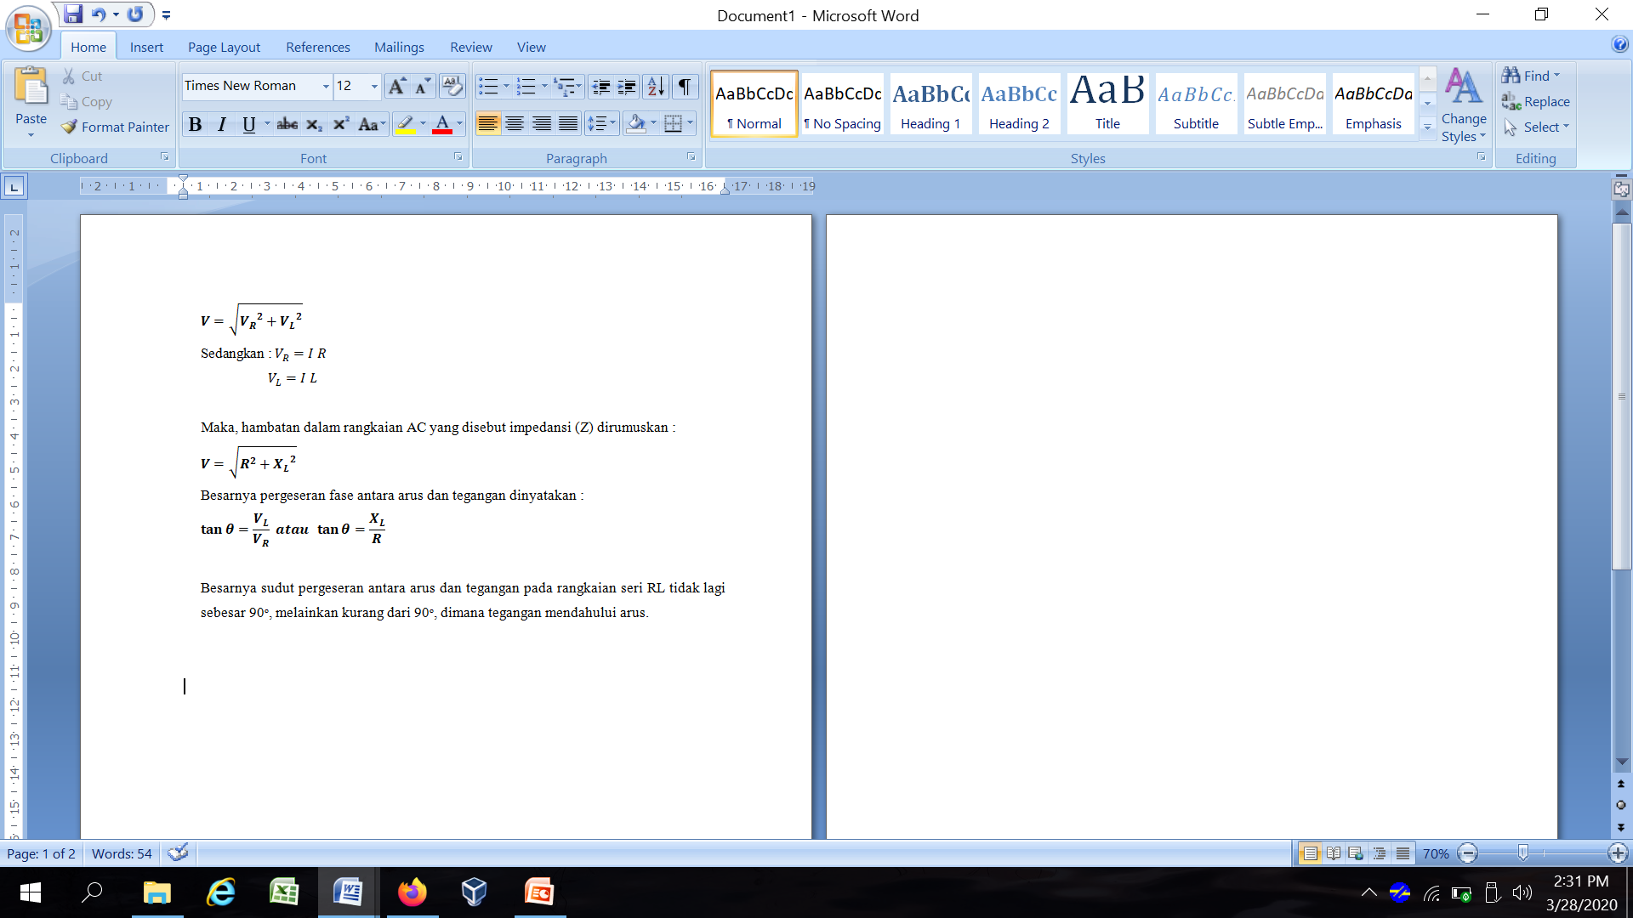
Rangkaian RL Seri
Gambar 2
Rangkaian RL Seri

Slide 4
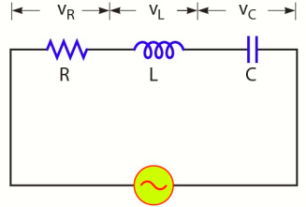
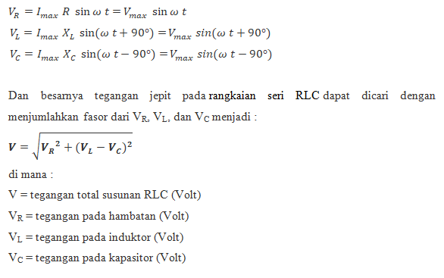
Rangkaian RLC Seri
Gambar 3
Rangkaian RLC Seri

Slide 5
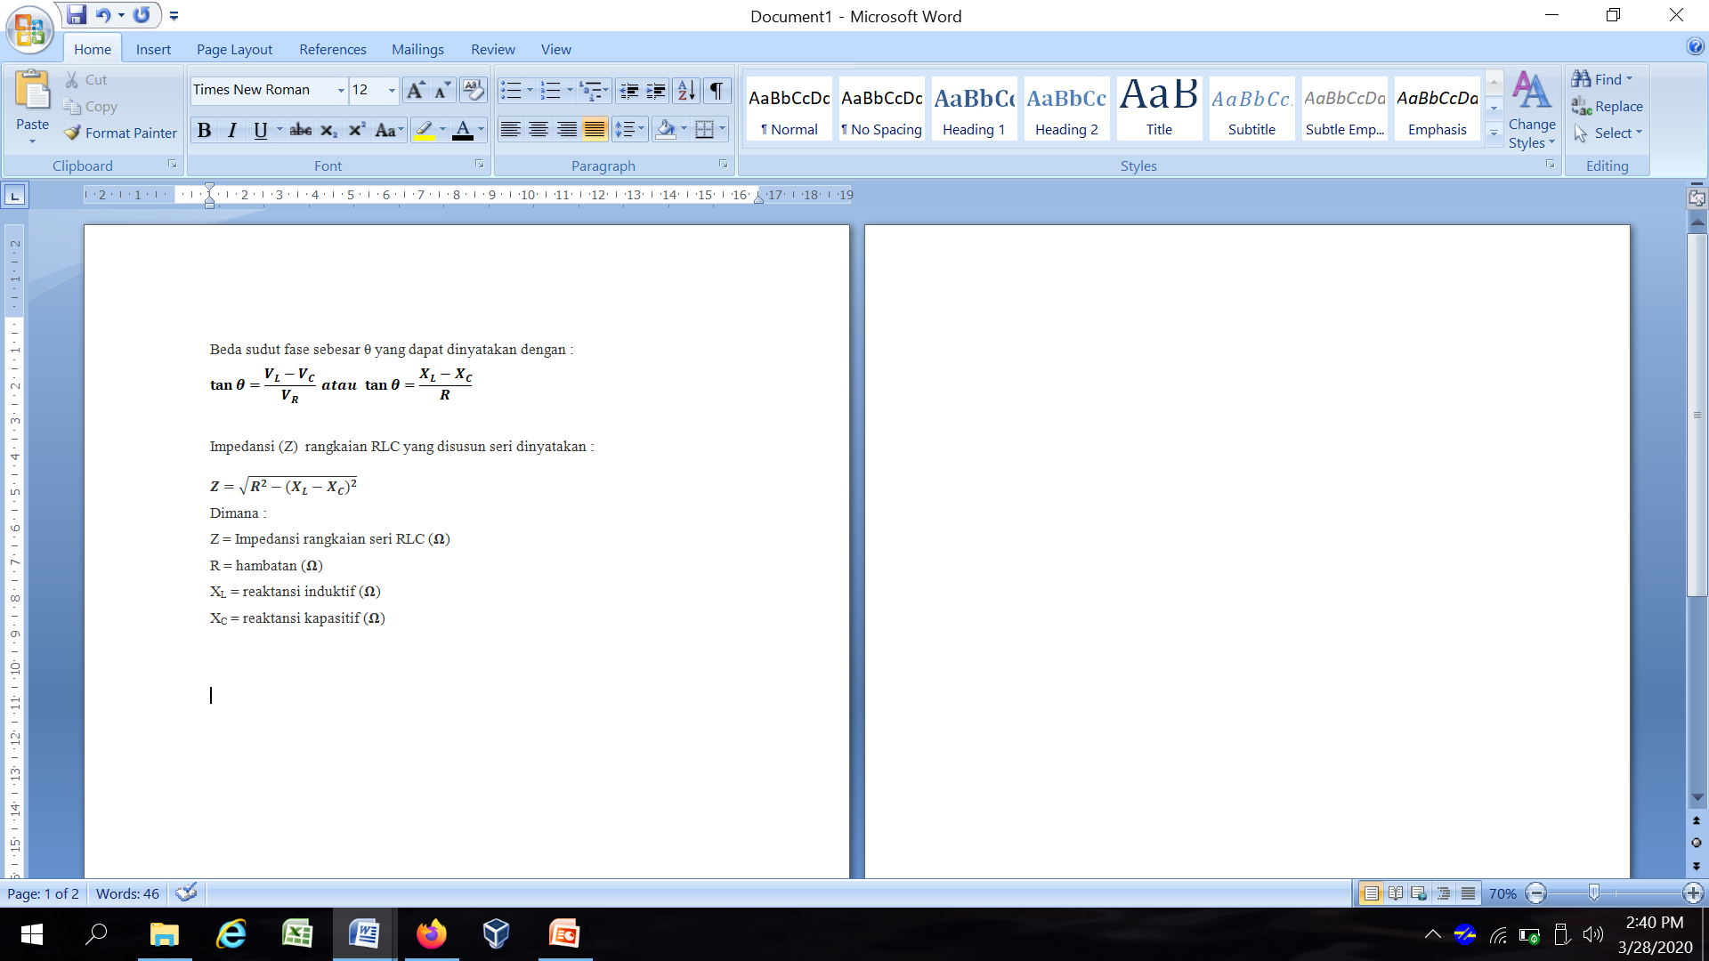
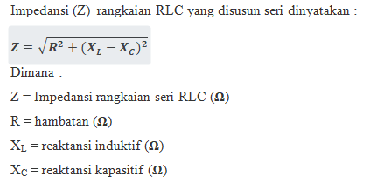
Rangkaian RLC Seri (Lanjutan)

Slide 6



Rangkaian RLC Seri (Lanjutan)
Beberapa kemungkinan pada rangkaian RLC Seri
X_{L} > X_{C} → rangkaian bersifat seperti induktor
tegangan mendahului arus dengan beda sudut fase θ
X_{L} = X_{C} → Z = R
terjadi resonansi deret/seri yang besarnya frekuensi resonansi dapat dicari yaitu :
X_{L} < X_{C} → rangkaian bersifat seperti kapasitor
tegangan ketinggalan terhadap arus dengan beda sudut fase θ yang besarnya dinyatakan dengan

Slide 7
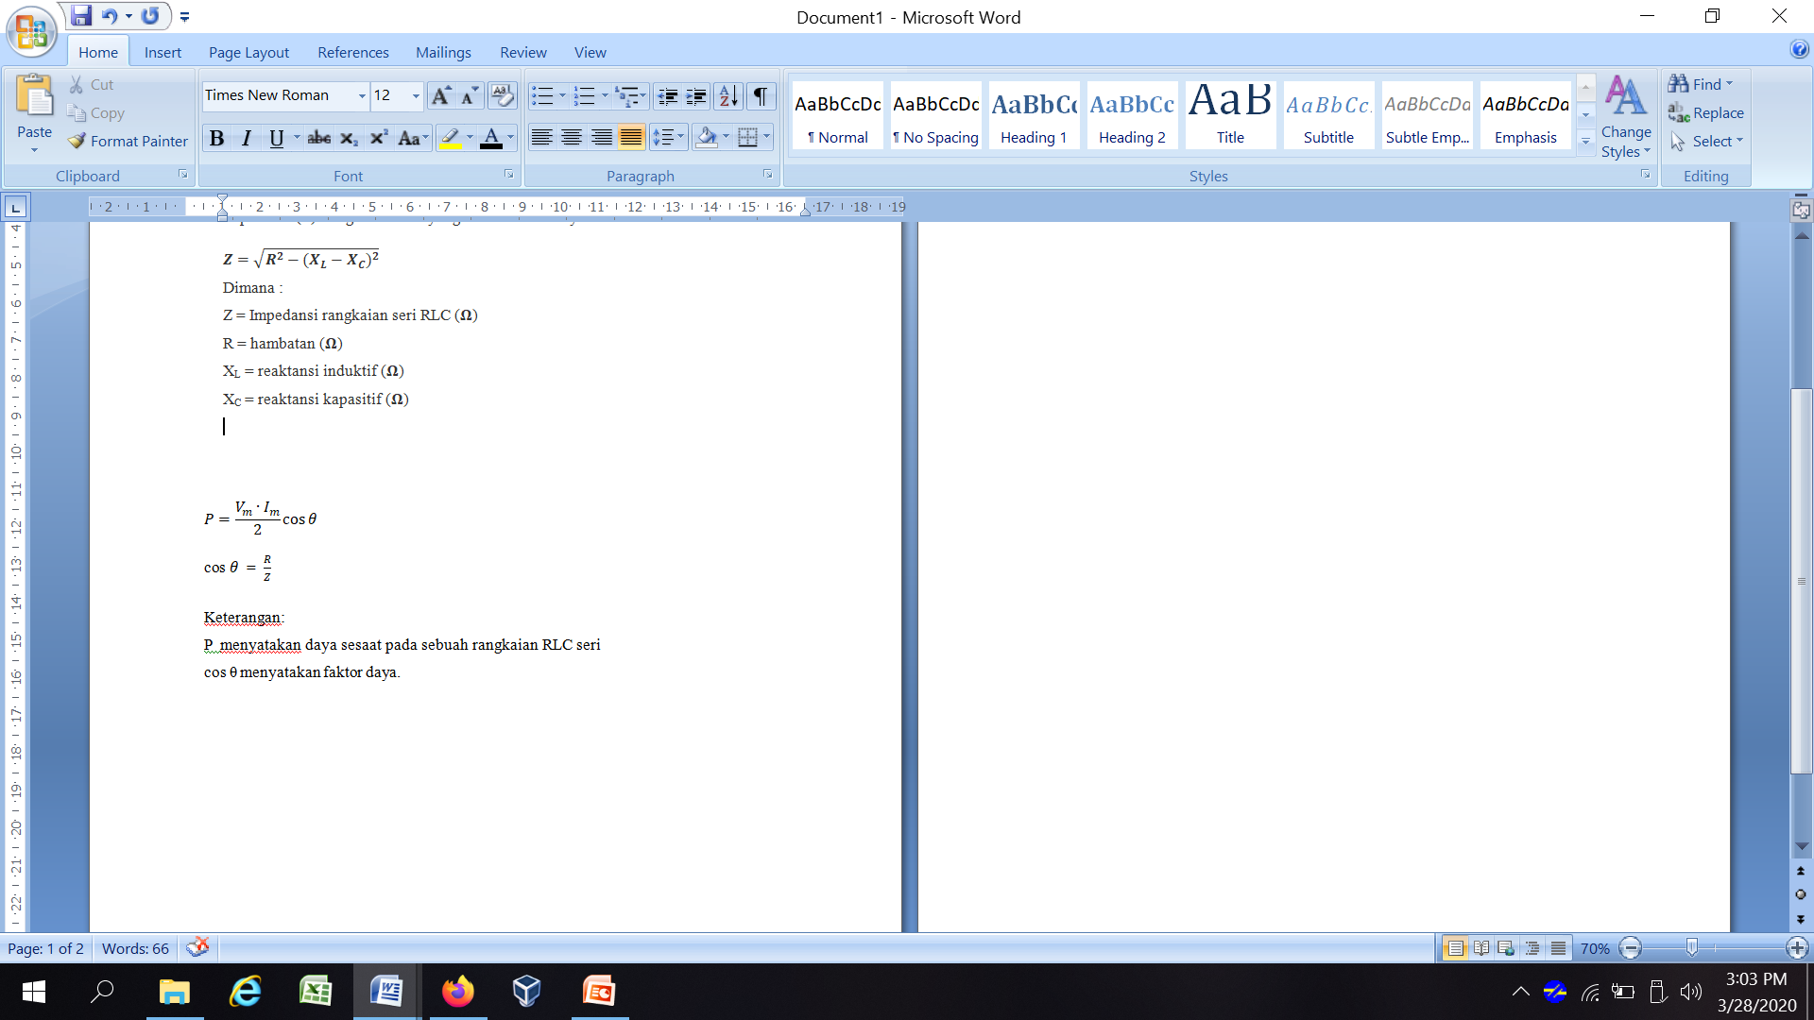
Faktor Daya
Keterangan:
P menyatakan daya sesaat pada sebuah rangkaian RLC seri
cos θ menyatakan faktor daya.

Slide 8
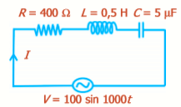
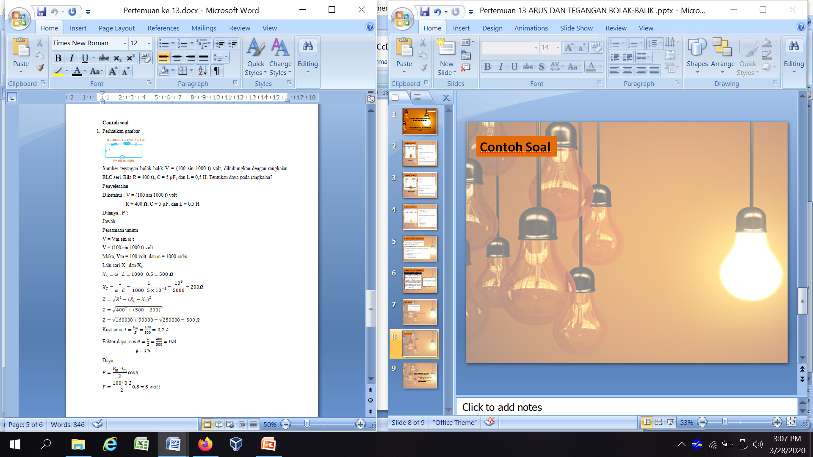
Contoh Soal

Slide 9
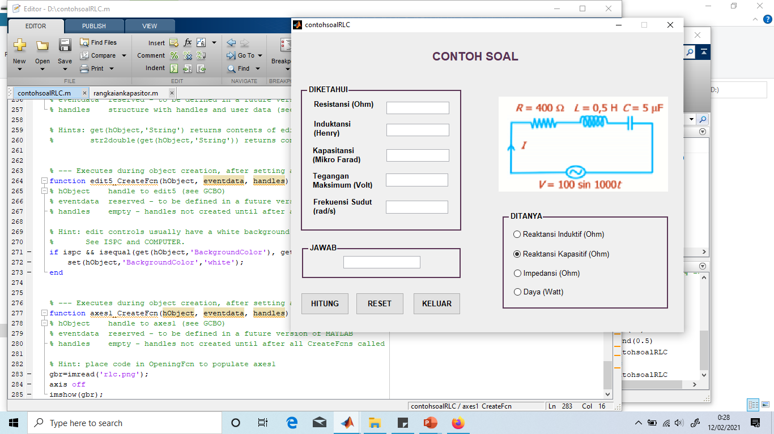
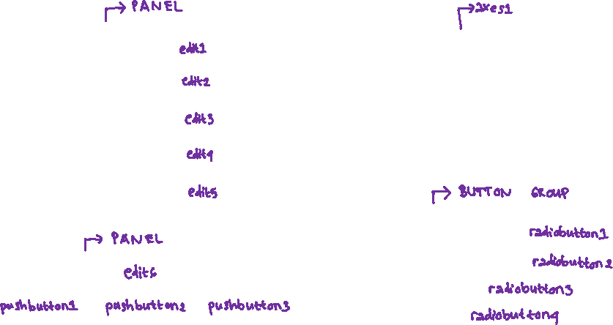
GUI UNTUK CONTOH SOAL DI ATAS
Warna ungu menunjukkan nama tag

Slide 10
SINTAK PROGRAM TOMBOL HITUNG
% --- Executes on button press in pushbutton1.
function pushbutton1_Callback(hObject, eventdata, handles)
% hObject handle to pushbutton1 (see GCBO)
% eventdata reserved - to be defined in a future version of MATLAB
% handles structure with handles and user data (see GUIDATA)
% input
R = str2double(get(handles.edit1,'string'));
L = str2double(get(handles.edit2,'string'));
C = str2double(get(handles.edit3,'string'));
Vm = str2double(get(handles.edit4,'string'));
omega= str2double(get(handles.edit5,'string'));
%Menghitung Reaktansi Induktif
XL= omega*L;
%Menghitung Reaktansi Kapasitif
CC = C*(10^-6); %Mikro Farad diubah ke Farad
XC= 1/(omega*CC);
%Menghitung Impedansi
Z= sqrt (R^2 + (XL-XC)^2);

Slide 11
SINTAK PROGRAM TOMBOL HITUNG (LANJUTAN)
%Menghitung Daya
Im= Vm/Z;
costeta= R/Z;
P= ((Vm*Im)/2)*costeta;
a=get(handles.radiobutton1,'value');
b=get(handles.radiobutton2,'value');
c=get(handles.radiobutton3,'value');
d=get(handles.radiobutton4,'value');
if (a==1)
set(handles.edit6,'string',XL);
elseif (b==1)
set(handles.edit6,'string',XC);
elseif (c==1)
set(handles.edit6,'string',Z);
else
set(handles.edit6,'string',P);
end

Slide 12
SINTAK PROGRAM TOMBOL RESET
% --- Executes on button press in pushbutton2.
function pushbutton2_Callback(hObject, eventdata, handles)
% hObject handle to pushbutton2 (see GCBO)
% eventdata reserved - to be defined in a future version of MATLAB
% handles structure with handles and user data (see GUIDATA)
set(handles.edit1,'string', ' ');
set(handles.edit2,'string', ' ');
set(handles.edit3,'string', ' ');
set(handles.edit4,'string', ' ');
set(handles.edit5,'string', ' ');
set(handles.edit6,'string', ' ');
SINTAK PROGRAM TOMBOL KELUAR
% --- Executes on button press in pushbutton3.
function pushbutton3_Callback(hObject, eventdata, handles)
% hObject handle to pushbutton3 (see GCBO)
% eventdata reserved - to be defined in a future version of MATLAB
% handles structure with handles and user data (see GUIDATA)
close;

Slide 13
SINTAK PROGRAM MEMASUKKAN GAMBAR
% --- Executes during object creation, after setting all properties.
function axes1_CreateFcn(hObject, eventdata, handles)
% hObject handle to axes1 (see GCBO)
% eventdata reserved - to be defined in a future version of MATLAB
% handles empty - handles not created until after all CreateFcns called
% Hint: place code in OpeningFcn to populate axes1
gbr=imread('rlc.png');
axis off
imshow(gbr);

Slide 14
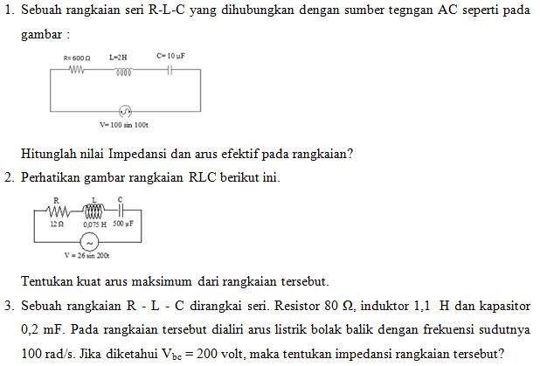
Latihan Soal

Slide 15
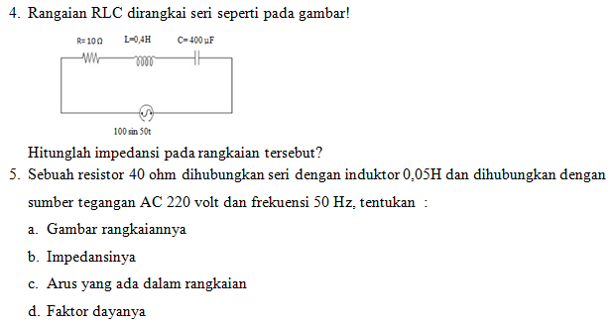

Slide 16
TERIMAKASIH
"Orang bijak belajar ketika mereka bisa. Orang bodoh belajar ketika mereka terpaksa." (Arthur Wellesley)

